Slide 1
Improving patient experience using AI
Student Number: 100611584
Module: Data Mining and Foundations of AI
Notes:
So, this presentation is on improving patient experience using AI. The project focusses on predicting patients at risk of clinical deterioration using healthcare data. I’ll be going through the process from problem definition to the evaluation and final product.

Slide 2
Problem Analysis
Problem Statement
The project is to develop an AI driven solution that predicts patients at risk of clinical deterioration based on healthcare data
Notes:
The goal here is to create an AI model that predicts patients at risk.
This is something that would be incredibly helpful for healthcare professionals in order to provide an earlier intervention for several medical problems. This ties closely into improving outcomes and reducing the strain on hospitals, post-pandemic.

Slide 3
Dataset
The dataset used for this project was sourced from Kaggle Here.
PURPOSE
simulate real-world healthcare data for training an evaluating AI models
useful in the healthcare context given it allows for testing ML algorithms without using sensitive patient data.
FEATURES
Demographic data – age, gender …
Health metrics – blood pressure, cholesterol levels, BMI …
Medical history – past diseases, medication, healthcare visits
Lifestyle data – physical activity, smoking, alcohol consumption
STRENGTHS
clean and well structured (to implement in AI based projects)
Helpful for various scenarios (can have different target variables)
LIMITATIONS
Might not fully represent complexity and noise of real-world data
Notes:
The dataset used was synthetic to simulate real healthcare records. It included features like age, vital signs, medical history, ad lifestyle factors.
While a clean and useful dataset for prototyping, it doesn’t capture the full complexity of real-world data, making it less suitable for evaluating how well a model would perform in an unpredictable, noisy clinical environment.

Slide 4
Ai model selection
When choosing models for an AI solution predicting patients at risk of clinical deterioration based on healthcare data, there are several factors to consider:
Problem type: the task is to classify patients based on the target variable; therefore, we’re working with classification models to categorise them into different risk groups
Feature types: since the dataset contains both categorical and continuous features, the model should be able to process both types of data effectively
Interpretability: while not used in this project, in general with the integration of AI into healthcare, a level of trust is needed from professionals. Having models that work well with explainability will ensure this trust and transparency, enabling a better understanding of the rationale behind predictions.
The Chosen Models: Random Forest and Logistic Regression were chosen for their complementary strengths. RF handles complex, mixed-type data well and captures the non-linear relationships however it can lack interpretability (which isn’t so much an issue in this project.) LR is simple, interpretable and ideal for clear clinical insights. However, it assumes linear relationships and may miss complex patterns.
The combination balances predictive power with transparency, fitting the needs of a healthcare setting such as this.
Notes:
The problem being solved is a classification one.
Random forest was chosen for its ability to handle complex patterns and mixed data types.
Logistic regression offers more simplicity and interpretability which is key for trust in clinical settings.

Slide 5
Development process
The problem of late deterioration detection was tackled by creating a binary target based on recovery time (> 5 days = at risk). Preprocessing steps like dropping irrelevant features, encoding categoricals, handling missing values, handling outliers and scaling numericals ensured clean, usable data.
An 80/20 split balanced training and evaluation. Random Forest was chosen to handle complex data patterns, while Logistic Regression provided a simple interpretable baseline.
Models were evaluated using accuracy using ROC-AUC, confusion matrix, and classification report to critically assess predictive performance in a clinical context.
Defining the problem
Creating the target variable
Data preprocessing
Train/test split
Model training
Random forest
Logistic regression
Model evaluation
Notes:
Since the original dataset didn’t include a ready-made label for predicting deterioration risk, I created a binary target variable called At_Risk. This was based on recovery time — anyone taking more than 5 days to recover was marked as ‘at risk’. This gave the model something meaningful to learn from.
Then I moved into preprocessing — removing irrelevant columns like ID, encoding categoricals for model compatibility, scaling numerical features for consistency, and handling outliers to reduce noise. After that, I split the data 80/20 to balance training and evaluation, trained Random Forest and Logistic Regression models, and finally applied SMOTE to fix the class imbalance, since there were fewer at-risk cases

Slide 6
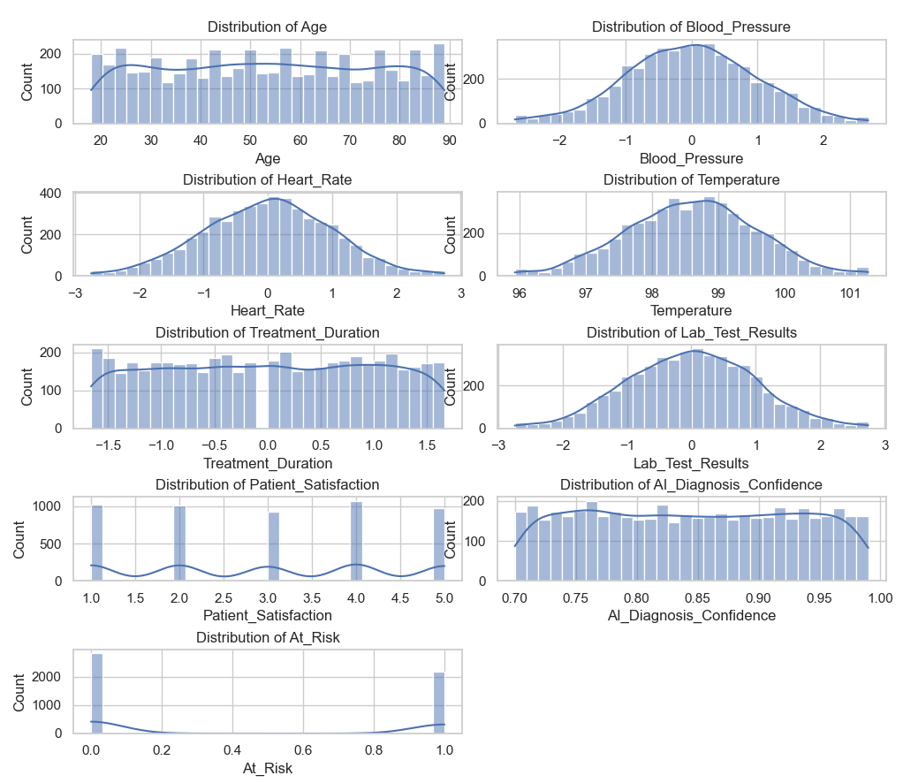
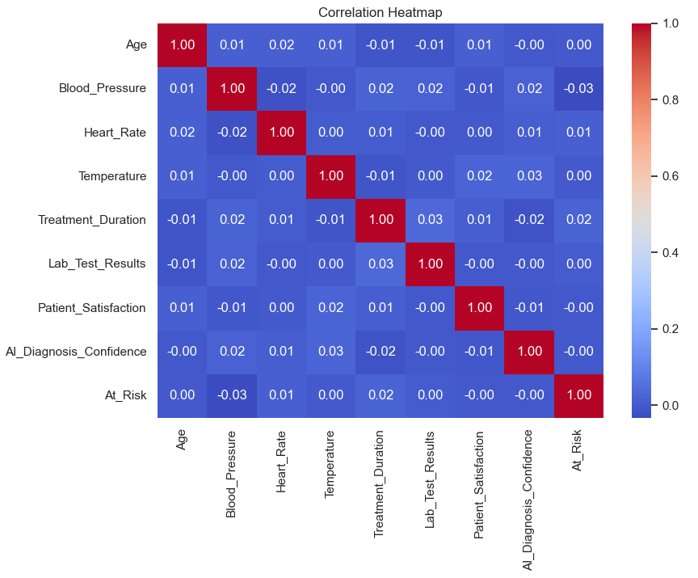
visuals
Here we can see the visualisations of feature distributions and correlations which helps guide the preprocessing decisions such as scaling, outlier handling and feature selection.
Notes:
The distribution plots (right) show how each feature is spread across the dataset. Most continuous variables like Blood Pressure and Lab Test Results follow a normal distribution, while categorical features like Patient Satisfaction are more discrete. These visuals helped identify scaling needs and potential outliers.
The correlation heatmap (left) highlights relationships between features. It shows weak correlations across most variables, which supports using models that handle low multicollinearity. Notably, At_Risk has low correlation with individual features, suggesting the need for ensemble methods like Random Forest to capture complex patterns.

Slide 7
implementation
Data Source: Synthetic healthcare dataset from Kaggle
Target: Predict patients at risk of clinical deterioration
Data splitting: 80/20 train test split on features and target (At_Risk)
Baseline models: Random Forest, Logistic Regression
Cross-validation: 5-fold cross validation to check model stability
Hyperparameter Tuning:
RF: n_estimators=200, max_depth=10
LR: C=0.5
Imbalance handling: applied SMOTE to improve prediction of minority class (At_Risk=1)
Evaluation metrics:
Accuracy
Precision, Recall, F1-score
Notes:
I trained both Random Forest and Logistic Regression models on the data. To assess how reliable they are, I used 5-fold cross-validation, which splits the data into multiple parts to test how consistent the model performs across different subsets , this helps avoid overfitting.
Next, I tuned the models’ hyperparameters, like increasing the number of trees and depth for Random Forest, and adjusting regularization for Logistic Regression , to try and improve performance.
Then I applied SMOTE, which is a method to generate new samples for the minority class , in this case, patients at risk. The dataset was imbalanced, meaning there were fewer at-risk cases, which can cause models to ignore them. By applying SMOTE after outlier removal, the model had more balanced data and could better learn the patterns associated with risk.

Slide 8
Evaluation & results
Both Random Forest and Logistic Regression were evaluated using accuracy, precision, recall, and F1-score. Baseline models achieved moderate accuracy (~54%) but struggled to identify at-risk patients, showing very low recall.
Hyperparameter tuning had minimal effect. However, after removing outliers and applying SMOTE, recall for the at-risk class significantly improved. Logistic Regression rose from 4% to 39%, and Random Forest from 16% to 28%.
This emphasizes the importance of addressing class imbalance and data quality in healthcare AI, where correctly identifying high-risk patients is far more critical than overall accuracy.
Model | Accuracy | Recall (At_Risk = 1)
Random Forest (Baseline) | 52.9% | 16%
Logistic Regression | 54.3% | 4%
RF (Tuned) | 53.6% | 3%
LR (Tuned) | 54.3% | 4%
RF (SMOTE) | 51.2% | 28%
LR (SMOTE) | 48.7% | 39%
Notes:
Here’s where we see the performance. Baseline models had okay accuracy around 54% but accuracy alone doesn’t tell the full story in healthcare. The real issue was recall for the at-risk class, which was extremely low 4% for Logistic Regression and 16% for Random Forest.
After tuning, performance stayed mostly the same it didn’t make a big difference. But once I applied SMOTE, recall for the at-risk group jumped: Logistic Regression went from 4% to 39%, and Random Forest from 16% to 28%. That’s huge in a clinical context where missing a high-risk patient could mean delayed care or worse outcomes.
So overall, this really shows that class imbalance is a bigger issue than model choice. Addressing it directly made the most impact.

Slide 9
Limitations & future improvements
Limitations:
Synthetic dataset – the dataset doesn’t reflect real-world patient complexity or noise.
Class imbalance – even with SMOTE, the models struggled with recall on small test sets.
Limited features – the dataset lacked real time or longitudinal patient data (data over time).
Model performance – accuracy stayed low despite tuning, especially with the minority classes.
Future Improvements:
Source a more realistic, representative dataset to improve model generalisability.
Exploring more advanced models to handle class imbalance more effectively and perhaps achieve a better performance on the dataset.
Adding ROC-AUC analysis for a deeper evaluation into the classification thresholds.
Implement feature importance and/or an explainability framework to better understand model predictions and support clinical trust.
Notes:
There were a few key limitations. First, the dataset was synthetic it was clean and easy to work with, but it didn’t reflect the messiness of real-world patient data like missing values, noise, or rare edge cases. That limits how realistic our model performance is.
Second, even with SMOTE, the models still had trouble consistently identifying the minority class. This could be due to limited features for example, we didn’t have time-series data or live vitals which are often key in real clinical decision-making.
For future improvements, I’d look at testing this approach on a more realistic dataset, potentially one with longitudinal health data. I’d also consider trying more advanced models like Gradient Boosting or using ensemble approaches to handle imbalance better. And adding model explainability tools like SHAP would help make the predictions more transparent for clinicians

Slide 10
conclusion
This project demonstrates how machine learning models and AI can be applied to healthcare data to predict patterns and identify patients at risk of clinical deterioration.
While baseline models struggled with class imbalance, applying SMOTE improved recall for the at risk-group, highlighting the importance of prioritising patient safety over overall accuracy.
Through model tuning, evaluation and critical reflection, this work provides the foundation for more effective, personalised and preventative AI-driven healthcare solutions.
Notes:
In summary, this project explored how AI can be used to improve patient experience by predicting risk of clinical deterioration. Although we started with simple models, and results weren’t perfect, the process revealed some key lessons.
The biggest takeaway was how important it is to handle data imbalance and outliers. Even more than tuning the model, those preprocessing steps made the real difference. This also shows how critical data quality is in healthcare AI.
While more work is needed to make it clinically applicable, this kind of project lays the groundwork for future solutions that are personalised, preventative, and ultimately improve patient outcomes with the support of AI

